Slide 1
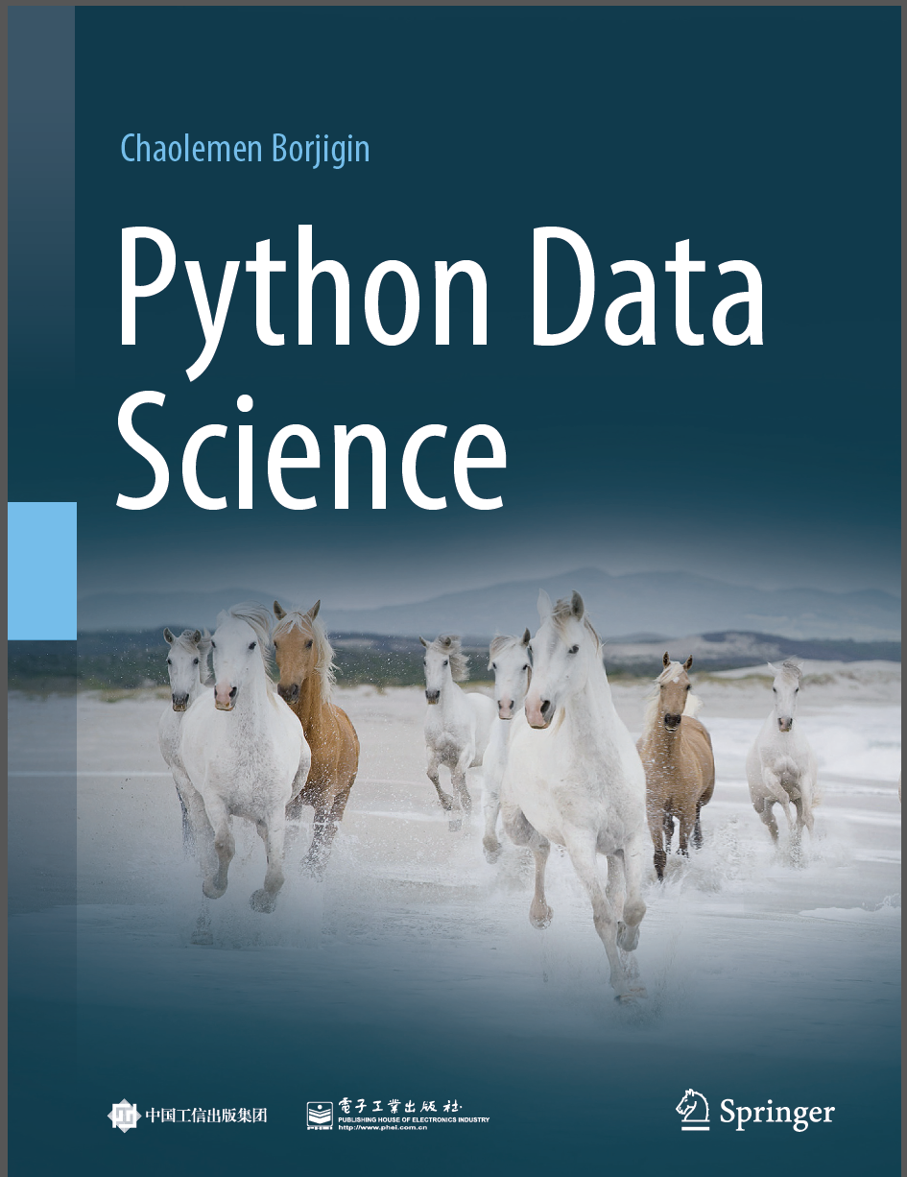
Python Data Science
Chaolemen Borjigin
Renmin University of China
chaolemen@ruc.edu.cn

Slide 2
3.6 Debugging
▼ Chapter 3 Advanced Python Programming for Data Science
► 3.6 Debugging
Chaolemen Borjigin
Renmin University of China
chaolemen@ruc.edu.cn

Slide 3
Summary of this chapter
▼ Chapter 3 Advanced Python Programming for Data Science
► 3.6 Debugging
3.6.1 Enabling the Python Debugger
3.6.2 Changing exception reporting modes
3.6.3 Working with checkpoints

Slide 4
3.6.1 Enabling the Python Debugger
▼Chapter 3 Advanced Python Programming for Data Science
► 3.6 Debugging
In[1]:
x=1
x1
---------------------------------------------------------------------------
NameError Traceback (most recent call last)
<ipython-input-1-8d773601edf7> in <module>()
1 x=1
----> 2 x1
NameError: name 'x1' is not defined

Slide 5
3.6.1 Enabling the Python Debugger
▼Chapter 3 Advanced Python Programming for Data Science
► 3.6 Debugging
In[2]:
%debug
> <ipython-input-1-8d773601edf7>(2)<module>()
1 x=1
----> 2 x1
ipdb> x
1
ipdb> x1
*** NameError: name 'x1' is not defined
ipdb> x
1
ipdb> q

Slide 6
3.6.2 Changing exception reporting modes
▼Chapter 3 Advanced Python Programming for Data Science
► 3.6 Debugging
In[3]:
%xmode Plain
y=1
Y
Exception reporting mode: Plain
Traceback (most recent call last):
File "<ipython-input-3-2ab22ce97508>", line 3, in <module>
Y
NameError: name 'Y' is not defined

Slide 7
3.6.2 Changing exception reporting modes
▼Chapter 3 Advanced Python Programming for Data Science
► 3.6 Debugging
In[4]:
%xmode Verbose
y=1
Y
Exception reporting mode: Verbose
---------------------------------------------------------------------------
NameError Traceback (most recent call last)
<ipython-input-4-4e5fe2f91061> in <module>()
1 get_ipython().run_line_magic('xmode', 'Verbose')
2 y=1
----> 3 Y
global Y = undefined
NameError: name 'Y' is not defined

Slide 8
3.6.2 Changing exception reporting modes
▼Chapter 3 Advanced Python Programming for Data Science
► 3.6 Debugging
In[5]:
%debug
> <ipython-input-4-4e5fe2f91061>(3)<module>()
1 get_ipython().run_line_magic('xmode', 'Verbose')
2 y=1
----> 3 Y
ipdb> y
1
ipdb> Y
*** NameError: name 'Y' is not defined
ipdb> y
1
ipdb> quit

Slide 9
3.6.3 Working with checkpoints
▼Chapter 3 Advanced Python Programming for Data Science
► 3.6 Debugging
In[6]:
a=1
b=0
assert b!=0,"The denominator can't equal 0"
---------------------------------------------------------------------------
AssertionError Traceback (most recent call last)
<ipython-input-6-441fadcfe486> in <module>
1 a=1
2 b=0
----> 3 assert b!=0,"The denominator can't equal 0"
global b = 0
AssertionError: The denominator can't equal 0

Slide 10
3.6.3 Working with checkpoints
▼Chapter 3 Advanced Python Programming for Data Science
► 3.6 Debugging
In[7]:
%debug
> <ipython-input-6-441fadcfe486>(3)<module>()
1 a=1
2 b=0
----> 3 assert b!=0,"The denominator can't equal 0"
ipdb> a
ipdb> b
ipdb> c

Slide 11


